Slide 1
COMP 3500 Introduction to Operating Systems Project 1 – Installing CentOS
Dr. Xiao Qin
Auburn University http://www.eng.auburn.edu/~xqin
xqin@auburn.edu
Notes:
Version 8.2 Aug. 2020
Version 7.3 Jan. 2017
We install CentOS 6.5
CentOS 7 Aug. 2015

Slide 2
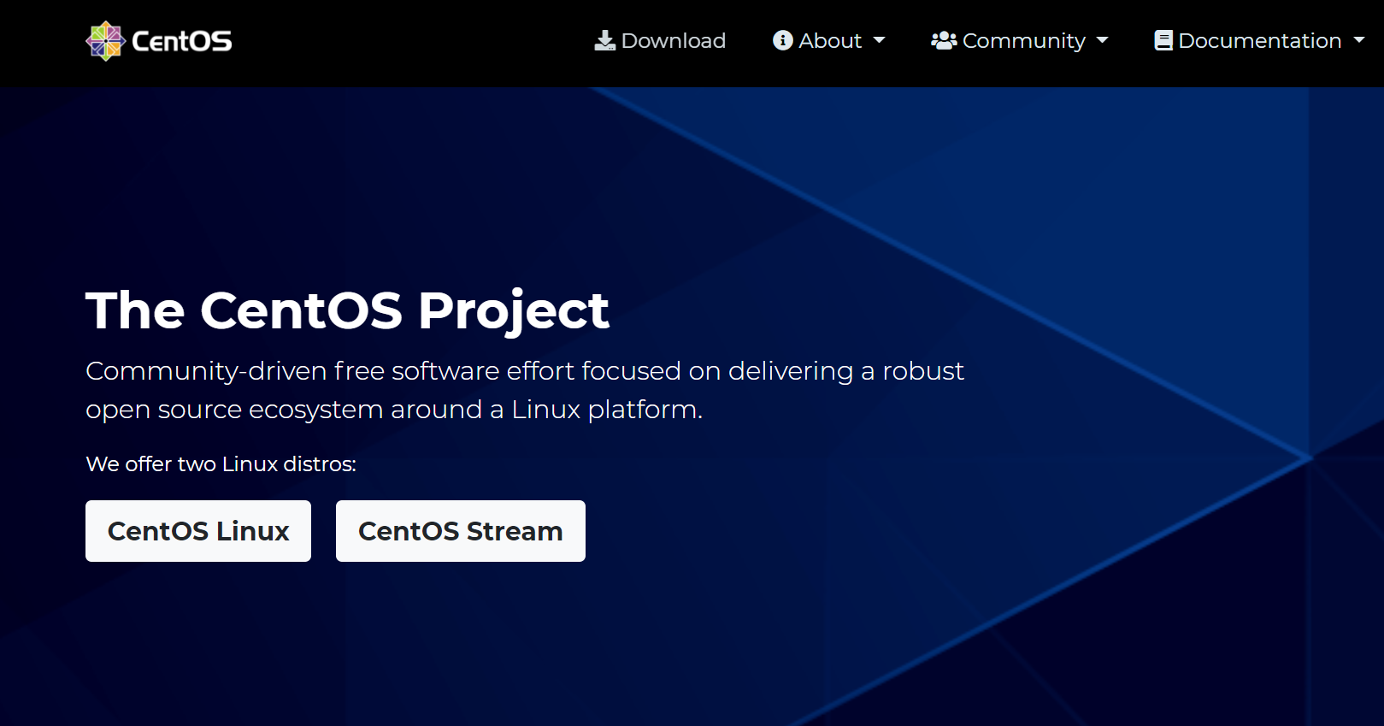

Slide 3
DevOps: development + operations (For Options 2-4)
Notes:
Project 1: this is an IT project (operations).
Story: Docker Containers
http://devops.com/2014/11/24/docker-vs-vms/
Reference: https://en.wikipedia.org/wiki/DevOps
DevOps (a clipped compound of development and operations) is a culture, movement or practice that emphasizes the collaboration and communication of both software developers and other information-technology (IT) professionals while automating the process of software delivery and infrastructure changes.[1][2] It aims at establishing a culture and environment where building, testing, and releasing software can happen rapidly, frequently, and more reliably.[3][4][5]

Slide 4
No Collaborate.
Each student should complete this project individually.

Slide 5
Project Objectives
Prepare a Linux operating system for your COMP 3500 projects
Get to know your computer in Shelby 2129 and the CentOS operating system (Option 3 only)
Learn basic Linux commands
14 Days to achieve the above three objectives!

Slide 6
Four Options
Option 1: use SSH to connect to a remote Linux server. Please read “Project 1 Option 1 Remotely Connect to Linux Machines.pdf” for details.
Option 2: install VirtualBox first on your computer followed by the installation of Linux. Please read “Project 1 Option 2 Install VirtualBox and CentOS.pdf” for details.
Option 3: Install CentOS on a PC in the OS laboratory (i.e., Shelby 2129).
Option 4: Dual-boot Linux and Windows on your own laptop/desktop computers.

Slide 7
Important Notice
(Option 1) On remote shared Tux machines, please don't use the "sudo" command. Please don’t attempt to install any tools.
(Option 2) Allocate a hard drive of at least 8 GB for your virtual machine.
(Option 3) You can only use the PC assigned to you in the OS laboratory (Shelby 2129).

Slide 8
Install CentOS
Insert your CD and reboot the system
Choose install.
Choose “Basic Storage Devices” for the device and “Use All Space” for the partition.
Reboot the computer
Do “yum -y update” to update all the packages.
You need to be the root to do this. (Not for Option 1)
Notes:
The Yellowdog Updater, Modified(yum) is an open-source command-line package-management utility for Linux operating systems using the RPM Package Manager.
Written in Python build on RPM Package Manager (RPM) (originally Red Hat Package Manager;

Slide 9
Tool 1: the script command
You to save a session of your Linux terminal.
A typescript of everything that happens.
$ script $Script started, file is typescript $ cd $ ls file1 file2 file3 $ exit exit Script done, file is typescript
Notes:
Teach students how to take notes.

Slide 10
Tool 1: the script command
$ script sample.script $Script started, file is typescript $ cd $ ls file1 file2 file3 $ exit exit Script done, file is sample.script
Notes:
Teach students how to take notes.

Slide 11
Tool 2: more
Displays text
One screen at a time.
#more /proc/cpuinfo
#more /proc/meminfo
Notes:
Teach students how to take notes.

Slide 12
Tool 3: gcc , the compiler
# gcc –v
# gcc –g -o simple simple.c
Notes:
Teach students how to take notes.

Slide 13
Tool 4: CVS->git (Concurrent Versions System)
Source code version control system
To merge multiple programmers modifications
To detecting conflicts when merges fail
Notes:
Teach students how to take notes.

Slide 14
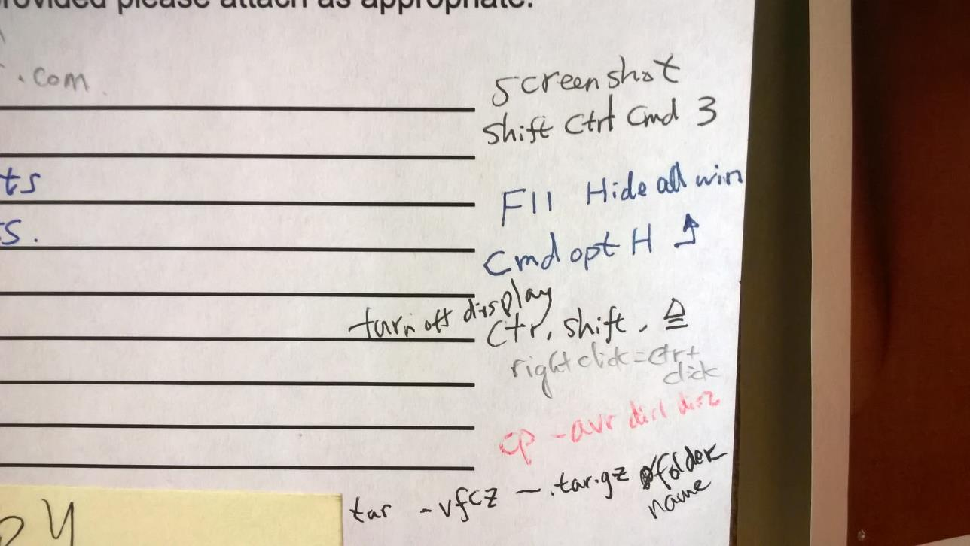
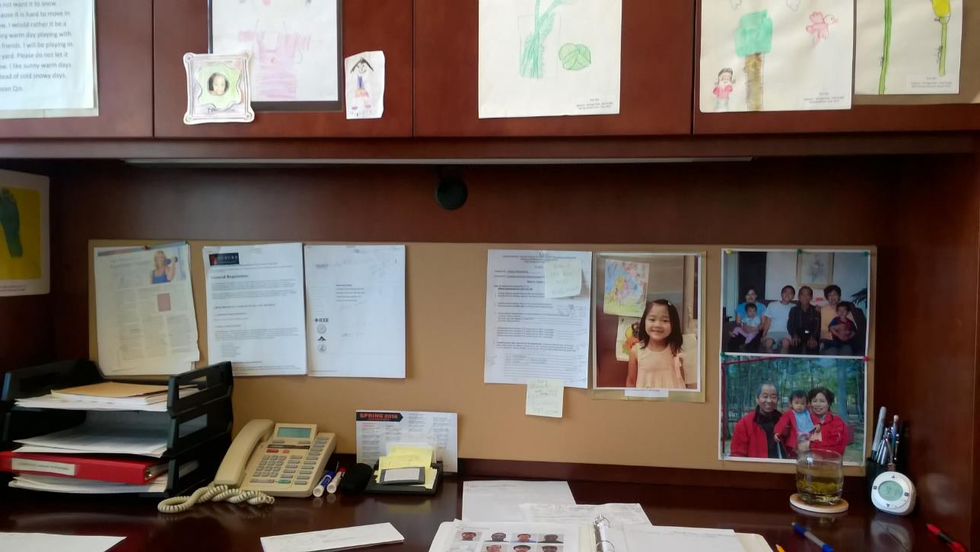
How to Learn Commands
Cheating sheet
Frequent Use and Naturally memorize
Notes:
Teach students how to take notes.

Slide 15
Project 1: How do we get the file off the computer and into Canvas?
The sftp command
mount a flash drive
Add a desktop environment

Slide 16
The sftp Command
You may use the sftp command to transfer files from your lab PC into the engineering’s tux machines. For example, you can start using this command on your lab PC's terminal as, assuming your engineering user name is xzq0001:
#sftp xzq0001@scp.eng.auburn.edu
Then, you can easily access your transferred files on your engineering machines. For more information on how to use sftp, please refer to the “Transferring Files with SFTP” section of this webpage:
https://www.digitalocean.com/community/tutorials/how-to-use-sftp-to-securely-transfer-files-with-a-remote-server

Slide 17
mount a Flash Drive
You mount a flash drive, to which you copy the tarred archive. Then, you need unmount the flash drive. You then plug the flash drive into a laptop or another computer to upload the report to Canvas. Please refer to the following instructions on how to use mount and unmount commands in Linux:
http://www.thegeekstuff.com/2013/01/mount-umount-examples/

Slide 18
Add a Desktop Environment
You can add a desktop environment on your minimal CentOS. You may use the following command to add Gnome/GUI to your minimal CentOS install:
yum groupinstall basic-desktop desktop-platform x11 fonts
A long version is given below:
yum groupinstall "Desktop" "Desktop Platform" "X Window System" "Fonts"

Slide 19
Project 1: What’s the report format?
Option 1: A single File
“project1.pdf”
A Tarball for Multiple Script Files
%tar vfzc project1.tgz ~/comp3500/project1

